Slide 1


CommuteWave
API BASED PRODUCTS

Slide 2
Introduction to CommuteWave
A Simple platform that allows users to book the shuttle services.These API's enables organizations to streamline shuttle operations for employees. Employees can log in using their work email, view the nearest nodal point, check available shuttles, and reserve a seat. Shuttle operators can manage shuttle schedules, routes, and details.vices, nodal points, bookings, drivers, and more.
This Shuttle Management Application provides a comprehensive and efficient solution for managing shuttle routes, bookings, and operations. With features designed for easy user interaction, secure access, and real-time updates, the system streamlines shuttle management for both employees and administrators.

Slide 3
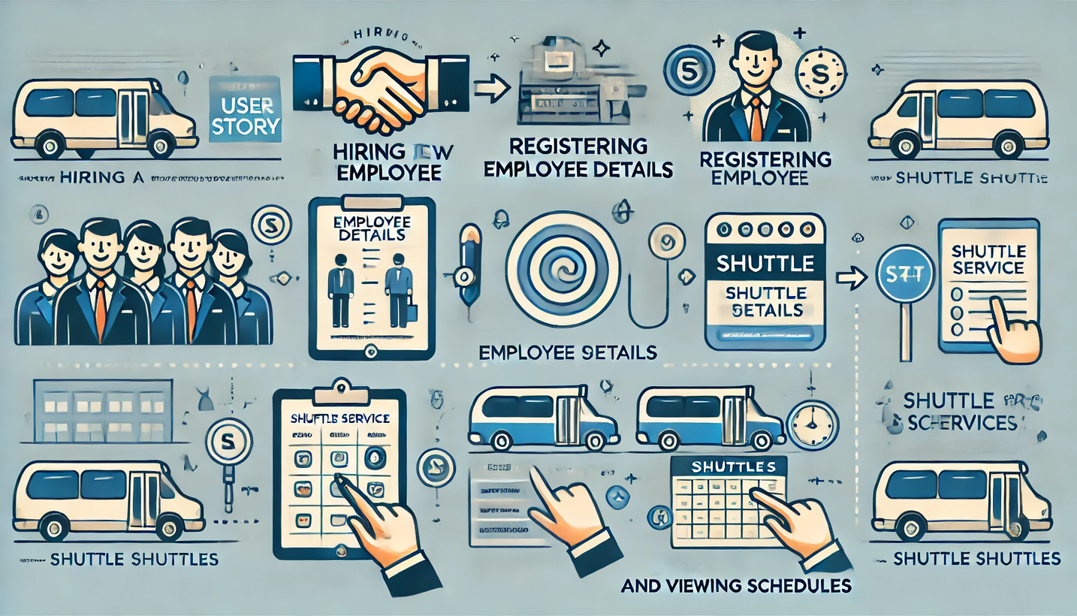
An overview of this project.

Slide 4
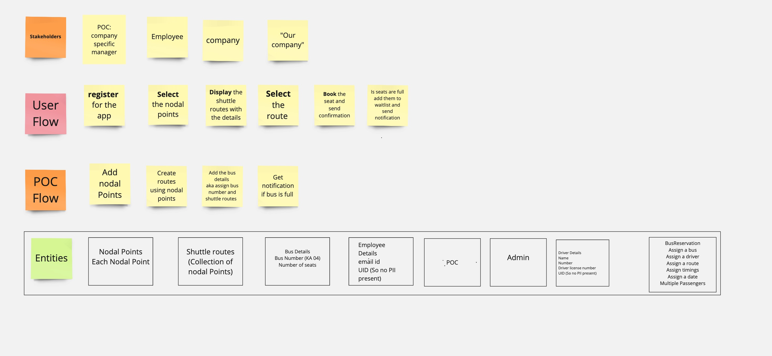
An overview of the entire process involved in this project.

Slide 5
Actors
Employee Management
Nodal
Points
Shuttle
Routes
Driver Management
Bus
Management
01
02
03
04
05

Slide 6
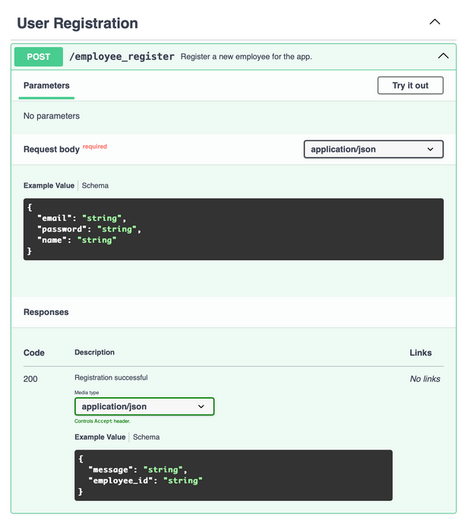
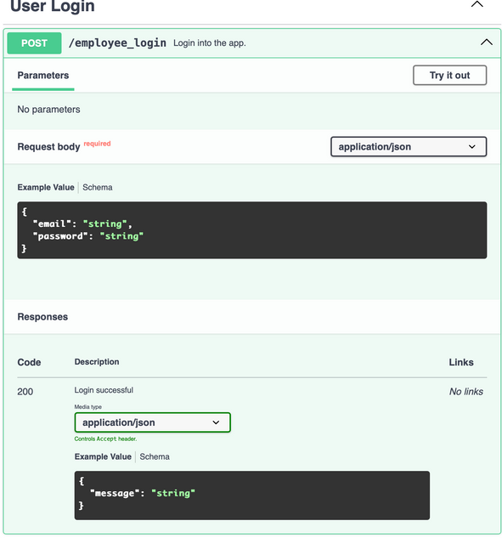
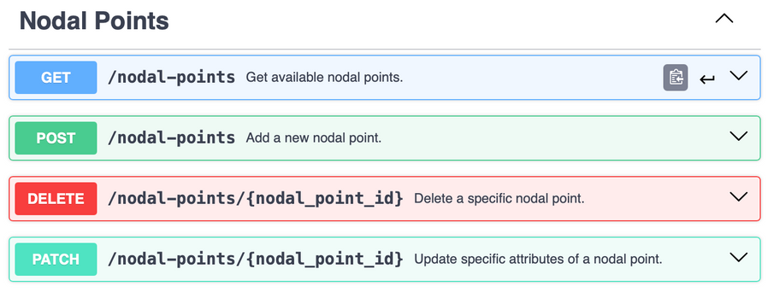
Employee Management
When the company hires a new employee who needs access to the shuttleservice,
They want to register their details in the system
POST /employee_register
Employee Login
When employee need to access the shuttle reservation system,
They want to log in using my email and password
POST /employee/login
Nodal Points
When I want to explore shuttle routes or plan my travel,
I want to view a list of available nodal points, so that I can determine where to board or alight for my journey.
GET /nodal_points
01
02
03

Slide 7
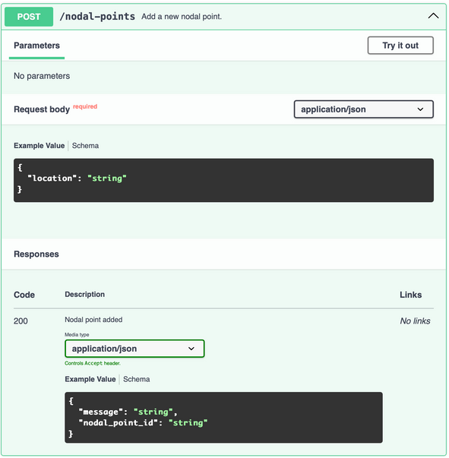
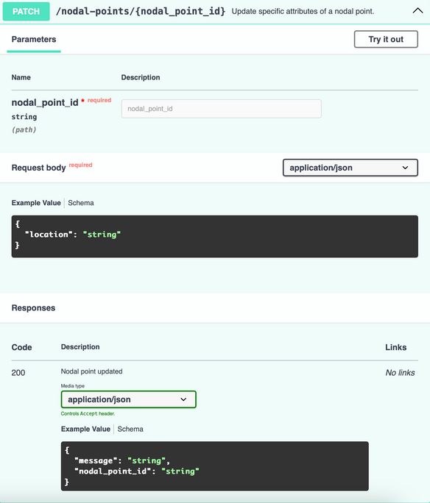
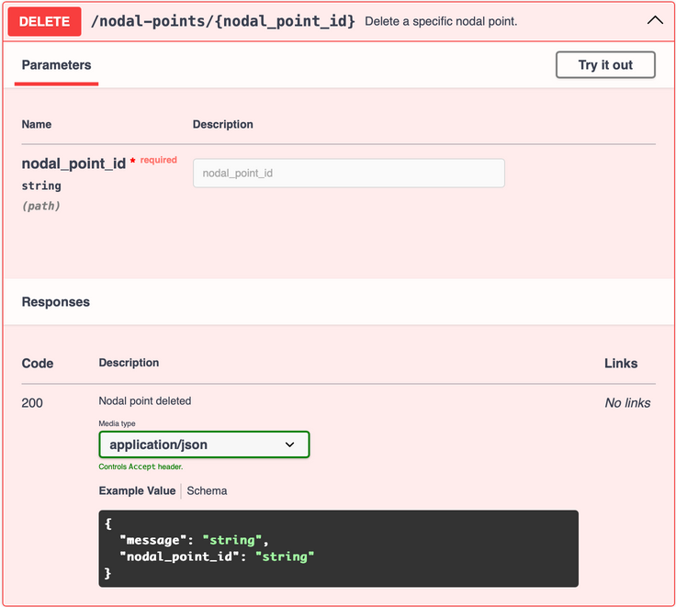
Patch Nodal Point
When a specific nodal point is need to be updated I want to update it from the system using its unique ID to keep the shuttle service data updated.
PATCH /nodal-points/{nodal_point_id}
Add Nodal Point
When new location is added for the shuttle service,I want to create a new nodal point in the system,so employees in that area can book shuttle services.
POST /nodal_points
Delete Nodal Point
When a specific nodal point is no longer needed or relevant, I want to delete it from the system using its unique ID to keep the shuttle service data updated.
DELETE /nodal-points/{nodal_point_id}

Slide 8
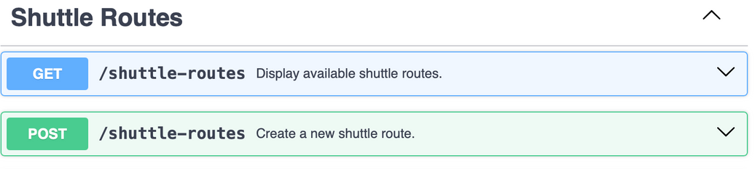
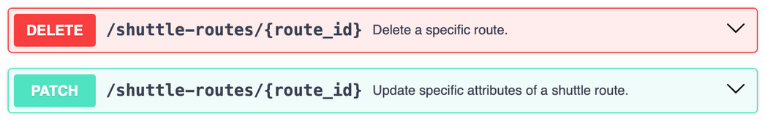
01
GET /shuttle_routes
03
DELETE /shuttle-routes/{route_id}
When the employee plan their commute,
They want to check the availability of shuttles for their chosen nodal point,
so that they can make an informed decision before booking
When I need to remove an outdated or unused shuttle route from the system,
I want to delete it by specifying the route ID,
so that the system stays up-to-date and no invalid routes are available for bookings.
Shuttle Routes
02
POST /shuttle-routes
04
PATCH /shuttle-routes/{route_id}
When I need to introduce a new shuttle route for the transportation system,
I want to define the start point, end point, and intermediate points of the route,
so that the system can accommodate new travel demands and expand the service network.
When employee need to travel to a nodal point at a specific time,
Employee want to book a shuttle for his preferred schedule,
so they can commute to my destination without delays.

Slide 9
Driver Management
Update Driver Details
When a driver’s information changes,I want to update their profile in the system, so the records remain accurate for operational needs.
PATCH /drivers/{driver_id}
Register Driver
When a new driver is hired to operate shuttle services, I want to register their details in the system, so that they can be assigned routes and integrated into the shuttle operations seamlessly.
POST /drivers
View Driver Details
When I am assigned a shuttle booking,I want to see the driver’s contact and vehicle details,so I can coordinate efficiently if needed.
GET /drivers
Delete Driver Details
When a driver is no longer required for shuttle operations or leaves the company, I want to remove their details from the system to accurately reflect only active drivers and keep the database clean.
DELETE /drivers/{driver_id}
01
02
03
04

Slide 10
Thank you

